Slide 1

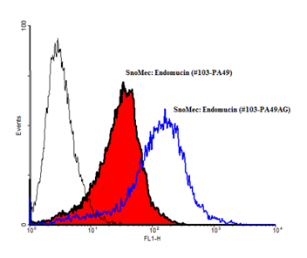
ReliaTech GmbH
Rabbit anti-mouse Endomucin
(Cat #103-PA49 / 103-PA49AG)
Fig. 1: FACS analysis with primary mouse endothelial cells (SnoMec).
http://www.reliatech.de / orders@reliatech.de

